Slide 1
RIPPLE COUNTERS
LECTURE 8

Slide 2
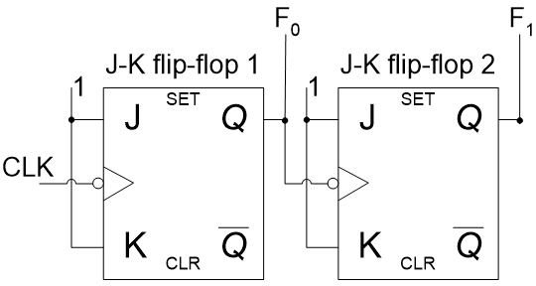
2-bit Asynchronous Up-Counter

Slide 3
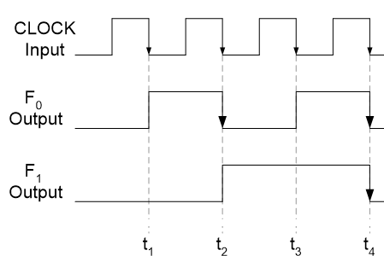
Timing Diagram
2-bit Asynchronous Up-Counter

Slide 4
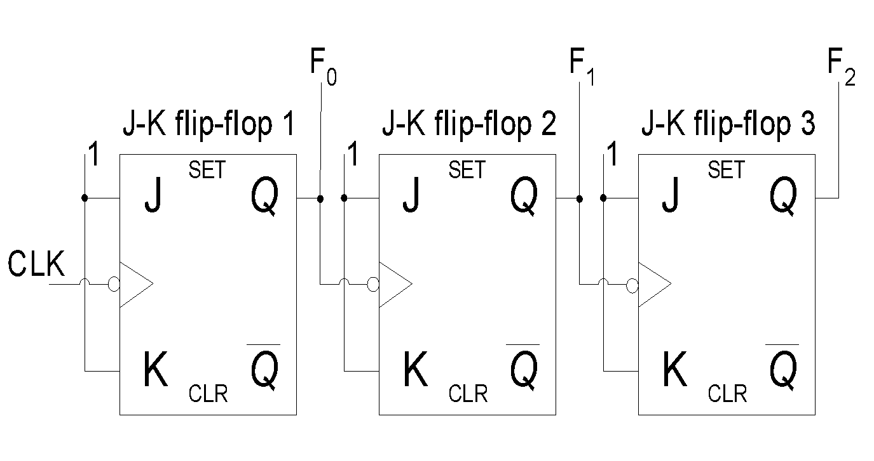
3-bit Asynchronous Up-Counter

Slide 5
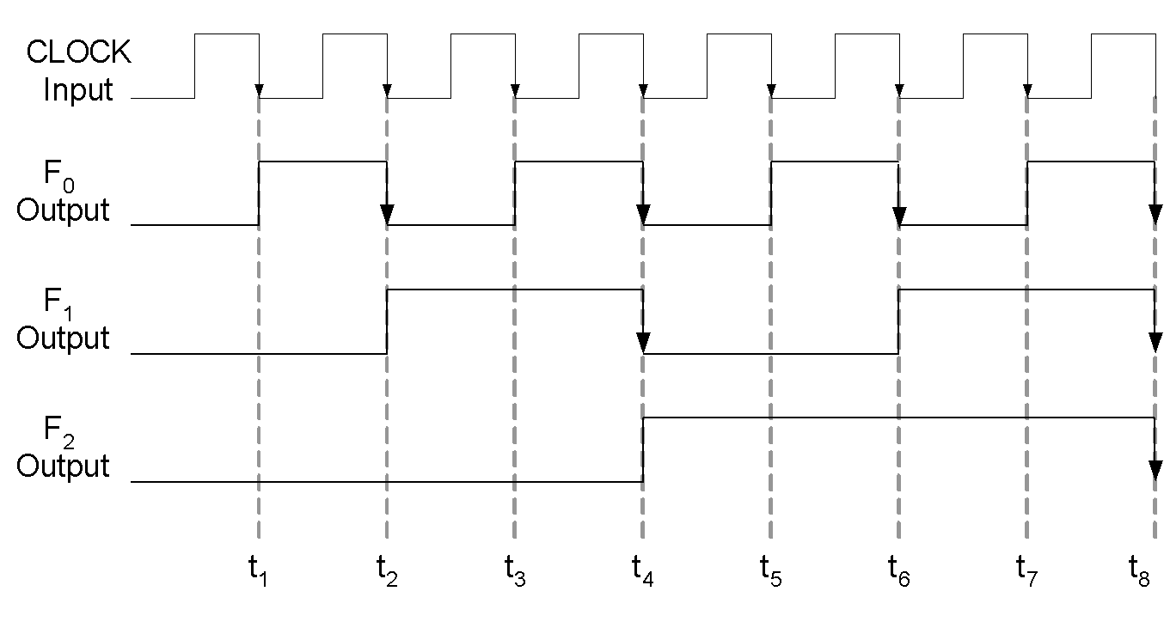
Timing Diagram
3-bit Asynchronous Up-Counter

Slide 6
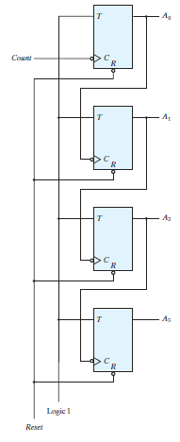
FOUR BIT BINARY RIPPLE COUNTER with T Flip Flop

Slide 7
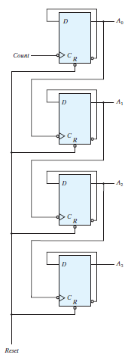
FOUR BIT BINARY RIPPLE COUNTER with D Flip Flop

Slide 8
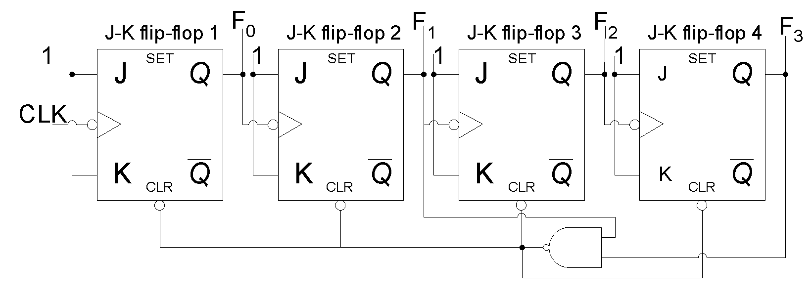
Asynchronous Decade Counter

Slide 9
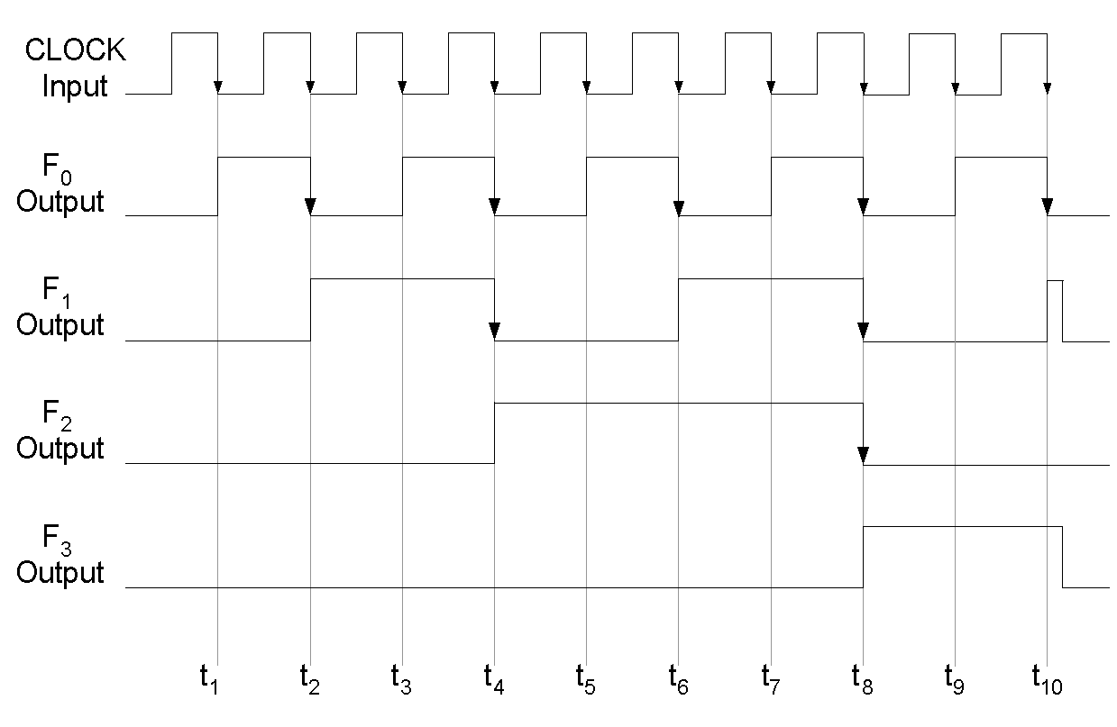
Timing diagram of a Decode Counter

Slide 10
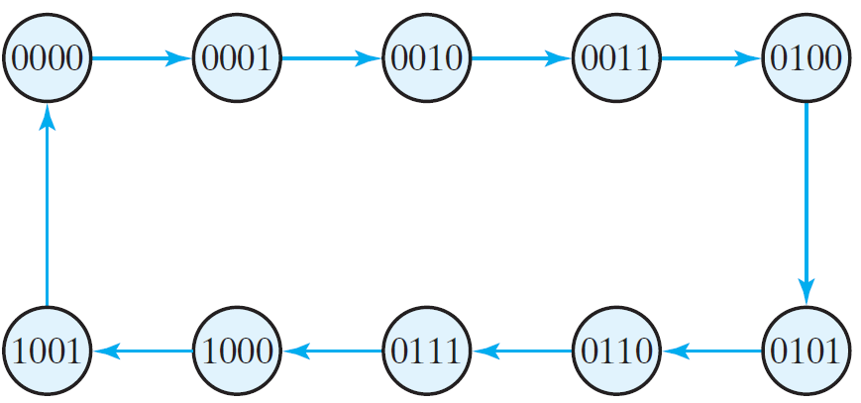
BCD Ripple Counter

Slide 11
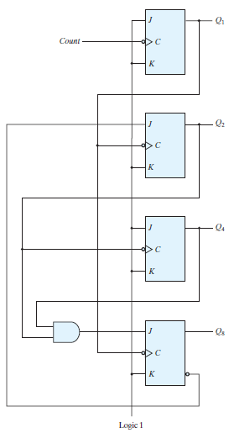
BCD Ripple Counter

Slide 12
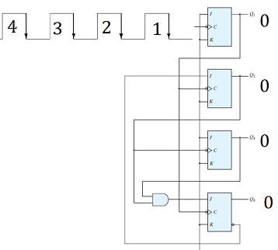
BCD Ripple Counter

Slide 13
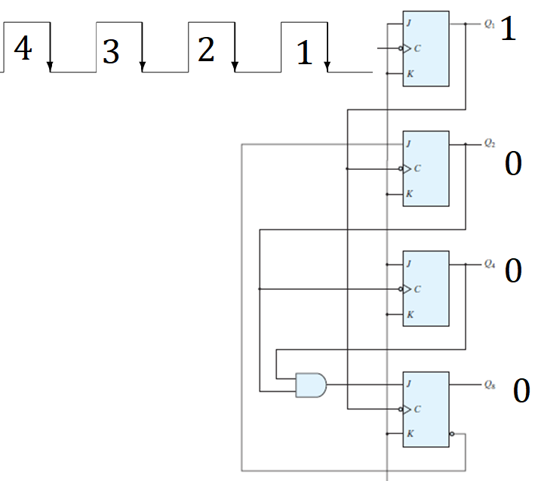
BCD Ripple Counter

Slide 14
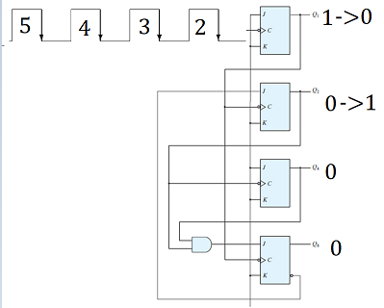
BCD Ripple Counter

Slide 15
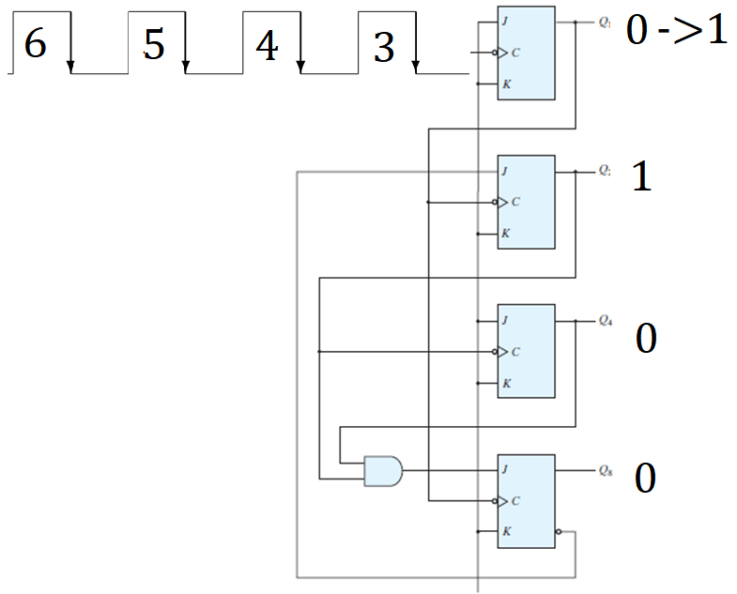
BCD Ripple Counter

Slide 16
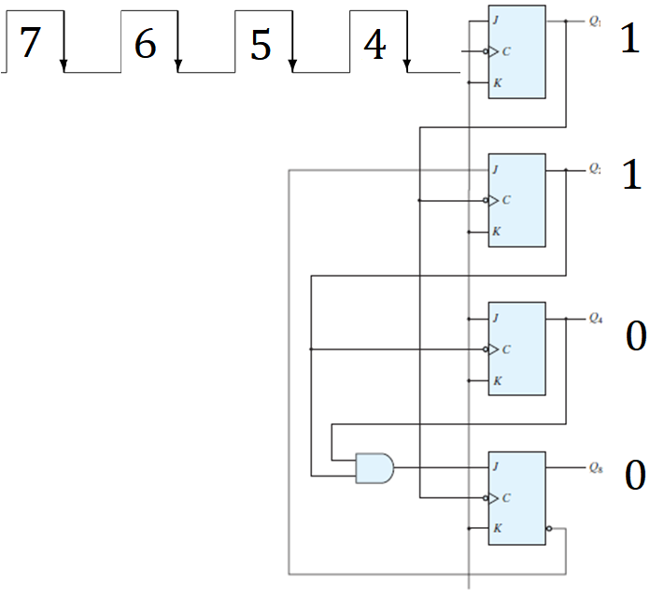
BCD Ripple Counter

Slide 17
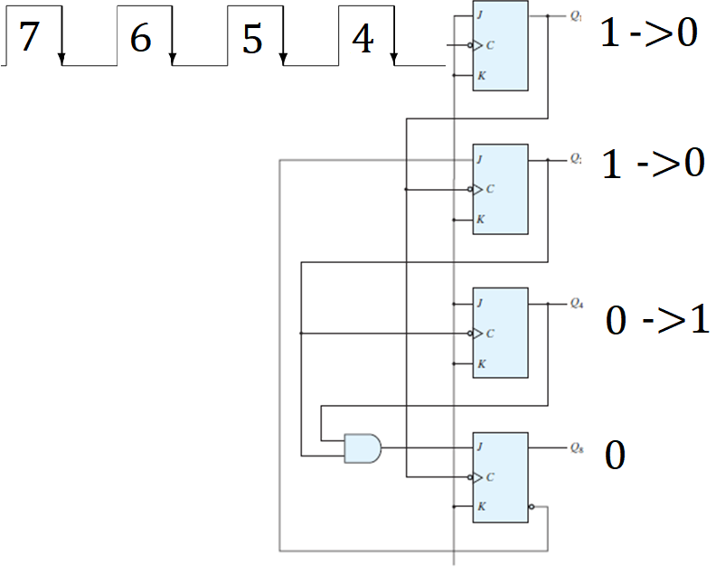
BCD Ripple Counter

Slide 18
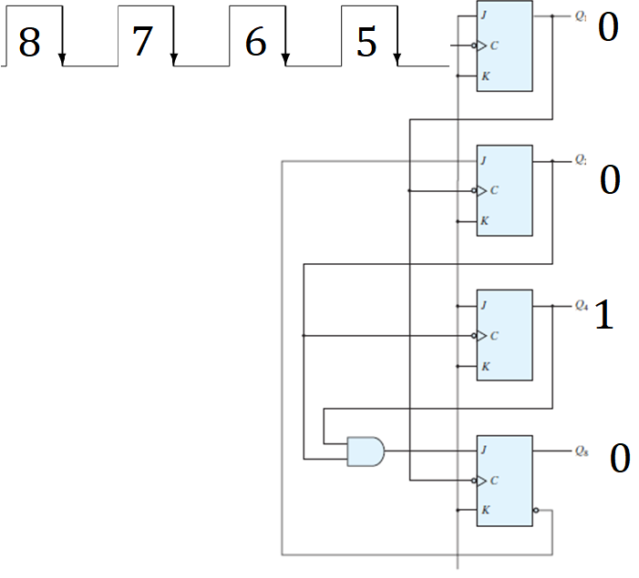
BCD Ripple Counter

Slide 19
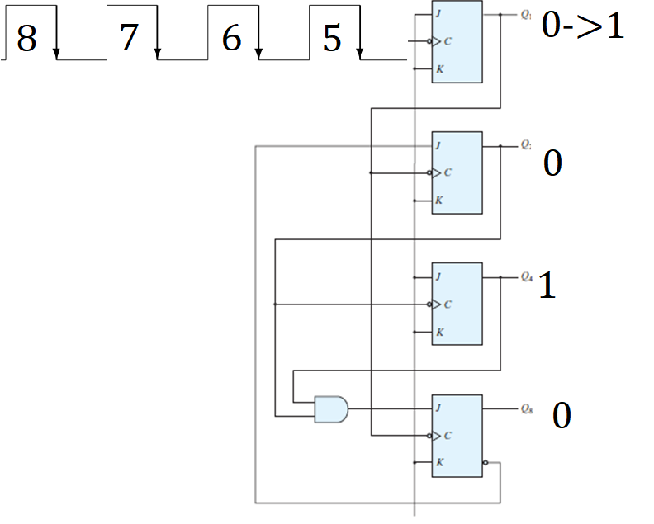
BCD Ripple Counter

Slide 20
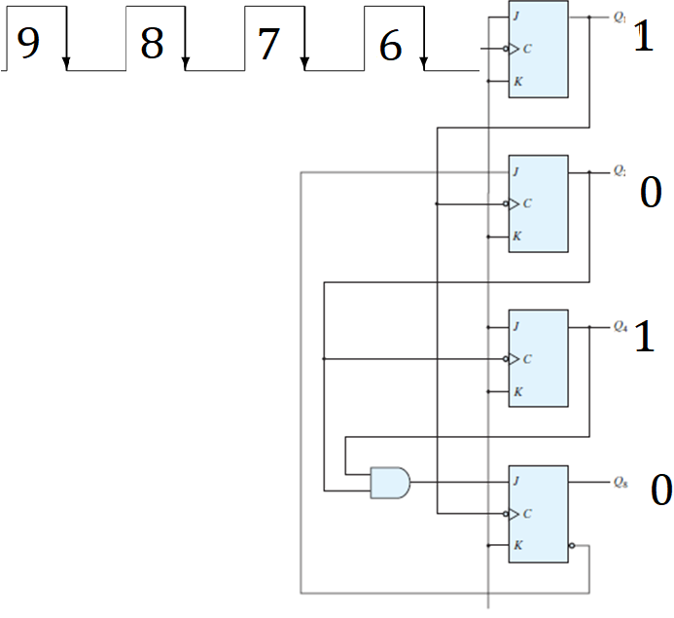
BCD Ripple Counter

Slide 21
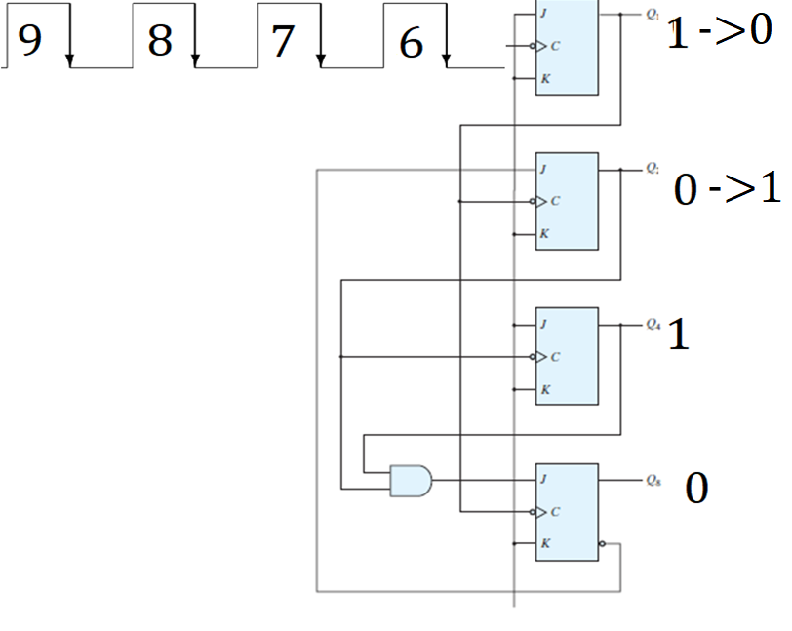
BCD Ripple Counter

Slide 22
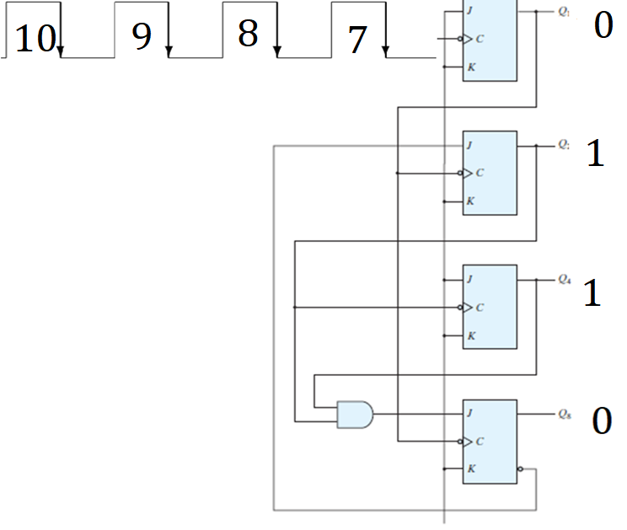
BCD Ripple Counter

Slide 23
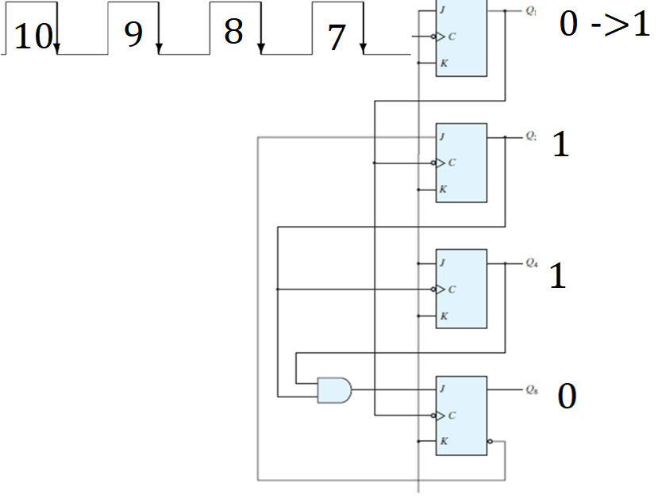
BCD Ripple Counter

Slide 24
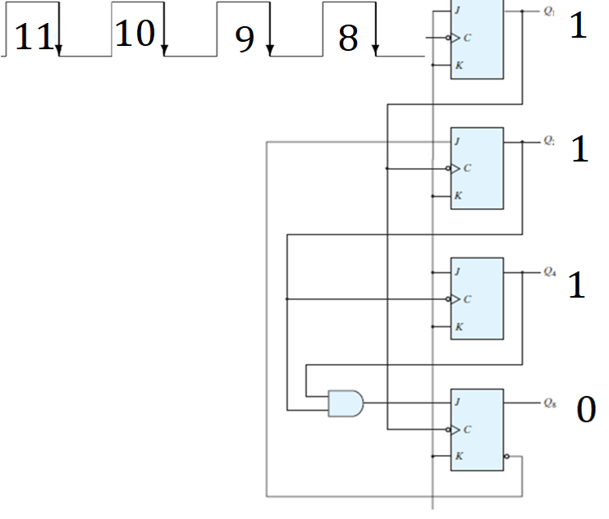
BCD Ripple Counter

Slide 25
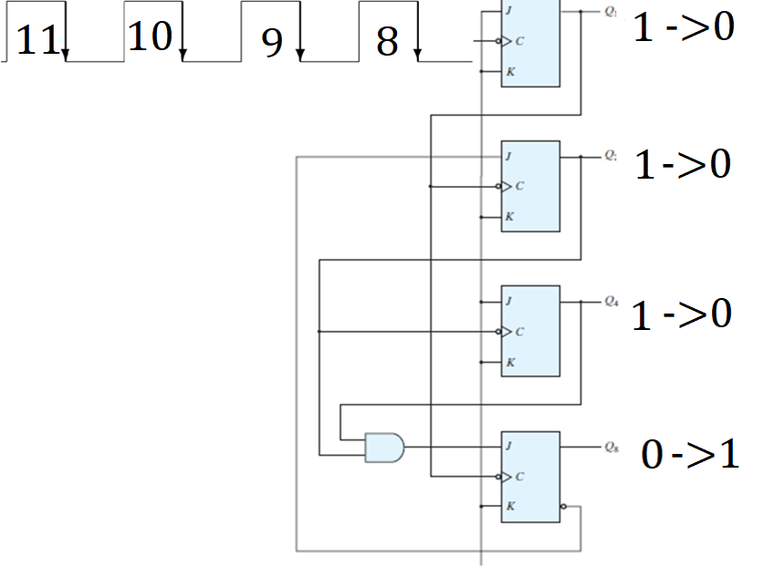
BCD Ripple Counter

Slide 26
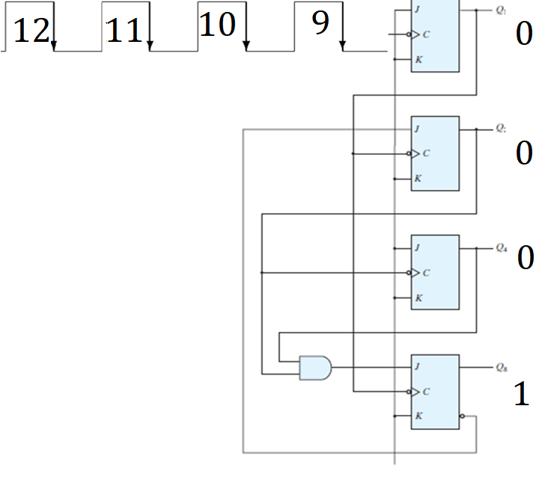
BCD Ripple Counter

Slide 27
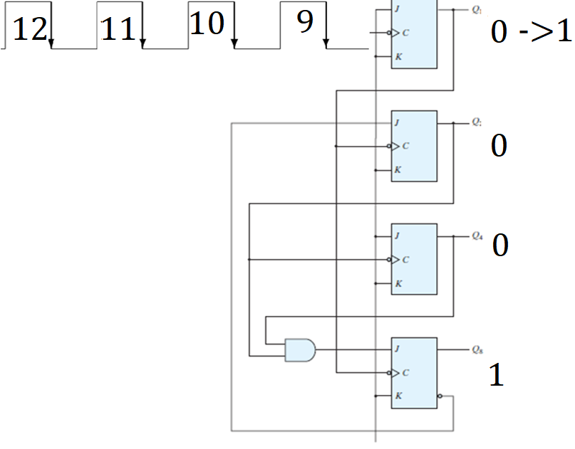
BCD Ripple Counter

Slide 28
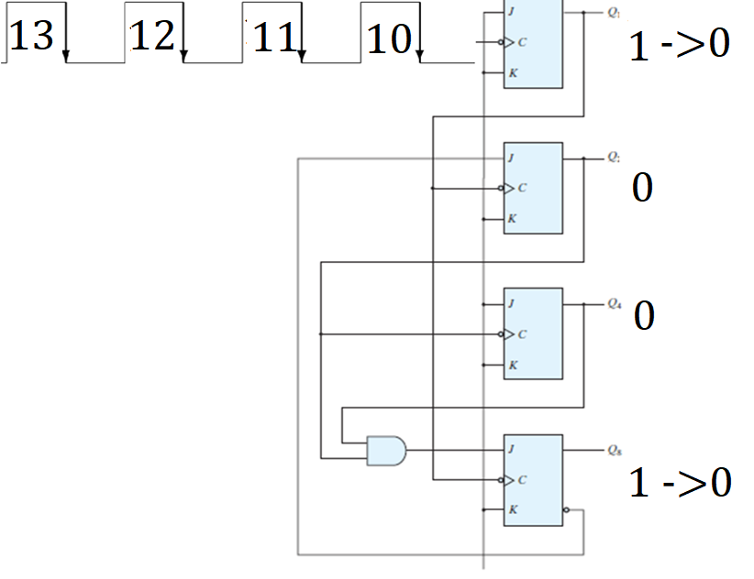
BCD Ripple Counter

Slide 29
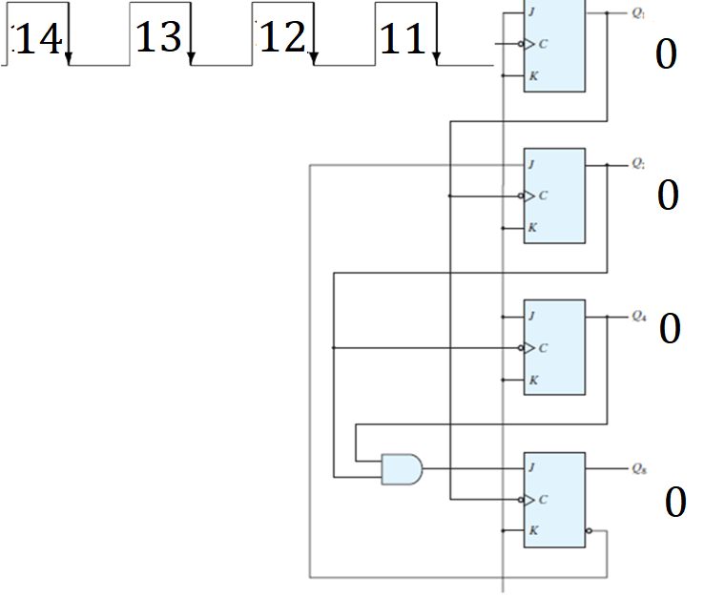
BCD Ripple Counter

Slide 30
THANKS

